Slide 1
Session 07
Routing
Subject : Z1451 / Jaringan Komputer Year : 2015

Slide 2
References
Main Reference Session 08: Forouzan, B.A., (2010). TCP/IP Protocol Suite, 4th Edition, Mc.Graw-Hill Chapter 6,7

Slide 3
Learning Outcomes
The students will be able to explain the role of routing protocols internetworking principles.

Slide 4
Outline
Routing Protocol
RIP
OSPF

Slide 5
Routing Protocols
Routing Information
About topology and delays in the internet
Routing Algorithm
Used to make routing decisions based on information
Routing algorithms are implemented using routing protocols

Slide 6
Autonomous Systems (AS)
Group of routers
Exchange information
Common routing protocol
Set of routers and networks managed by single organization
A connected network
There is at least one route between any pair of nodes

Slide 7
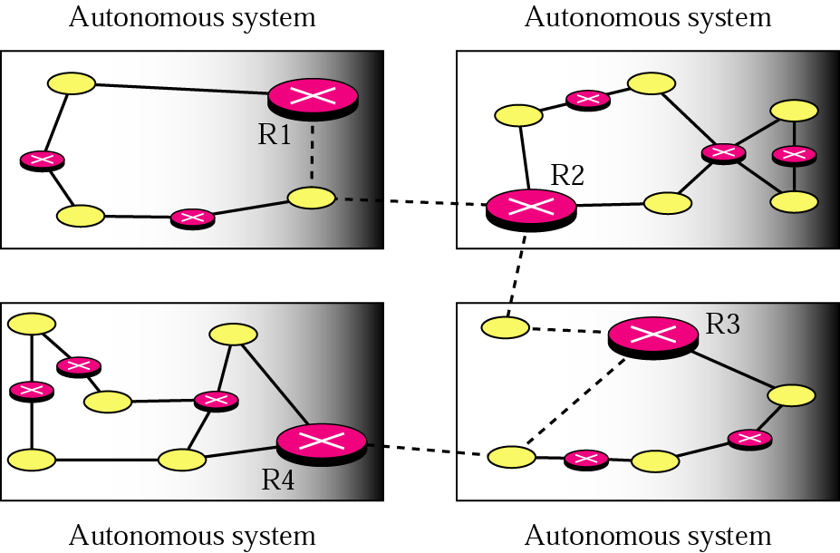
Autonomous systems

Slide 8
Interior Routing Protocol
Routing protocols that operate within a network (called an autonomous system) are called interior routing protocols.
Passes routing information between routers within AS
Routing algorithms and tables may differ between different AS
IRP needs detailed model

Slide 9
Exterior Routing Protocol
Exterior router protocol (ERP) is used for operating outside of or between networks
Because there are many more possible routes it is far more complex than interior routing
It cannot maintain tables of every single route and have to concentrate instead on the main routes only.
There may be more than one AS in internet
Routing algorithms and tables may differ between different AS
Routers need some info about networks outside their AS
ERP supports summary information on reachability

Slide 10
RIP
Routing Information Protocol (RIP)
Routing protocol commonly used on the Internet.
Computers using RIP broadcast routing tables every minute or so.
Now used on simpler networks
The original dynamic distance vector protocol

Slide 11
OSPF
Open Shortest Path First (OSPF)
Has overtaken RIP as the most popular interior routing protocol on the Internet
Has the ability to incorporate traffic and error rate measures in its routing decisions.
Sends updates state info, not entire routing tables, and only to other routers (not broadcasting them)
Each router keeps list of state of local links to network
Little traffic (less burdensome to the network since) as messages are small and not sent often
Route computed on least cost based on user cost metric using Link State Routing Algorithm
RFC 2328

Slide 12
Dynamic Routing Algorithms
Routing Algorithms
Distance Vector:
which uses the least number of hops to decide how to route a packet
Link State
which uses a variety of information types and takes into account such factors as congestion and response time to decide how to route a packet.
Because of its more sophisticated approach, link state routing algorithms have become more popular than distance vector algorithms.

Slide 13
Distance Vector
Each node (router or host) exchange information with neighboring nodes (both are directly connected to same network)
First generation routing algorithm for ARPANET
Node maintains vector of link costs for each directly attached network and distance and next-hop vectors for each destination
Requires transmission of lots of information by each router
Distance vector to all neighbors
Contains estimated path cost to all networks in configuration
Changes take long time to propagate

Slide 14
Link-state
Designed to overcome drawbacks of distance-vector
When router initialized, it determines link cost on each interface
Advertises set of link costs to all other routers in topology and not just neighboring routers
Then monitor link costs, if significantly changes, router advertises new set of link costs
Each router can construct topology of entire configuration and can calculate shortest path to each destination network

Slide 15
Link-state
Router constructs routing table, listing first hop to each destination
Router does not use distributed routing algorithm but can use any routing algorithm to determine shortest paths and in practice, Dijkstra's algorithm
Open shortest path first (OSPF) protocol uses link-state routing.

